Slide 1


Speed Control of DC Motor Using Artificial Neural Network Introduction DC motors are commonly employed in industry because of their ease and efficiency of speed control. Conventional PID controllers have been employed for this, but they tend to fail in the presence of nonlinearities and varying load conditions. This project investigates the application of an Artificial Neural Network (ANN) to control the speed of a DC motor. The ANN is trained on input data—current, voltage, and load—to estimate the desired speed. Performance of the ANN is then compared against that of a standard PID controller to assess any gains in adaptability and precision..
Speed Control of DC Motor Using Artificial Neural Network
Team Members & Roll Numbers:
BURLA SURAJ - CB.SC.U4AIE24105
VISHNU TEJA - CB.SC.U4AIE24130
SAI KARTHIK - CB.SC.U4AIE24107
MOHAN INANI - CB.SC.U4AIE24136

Slide 2
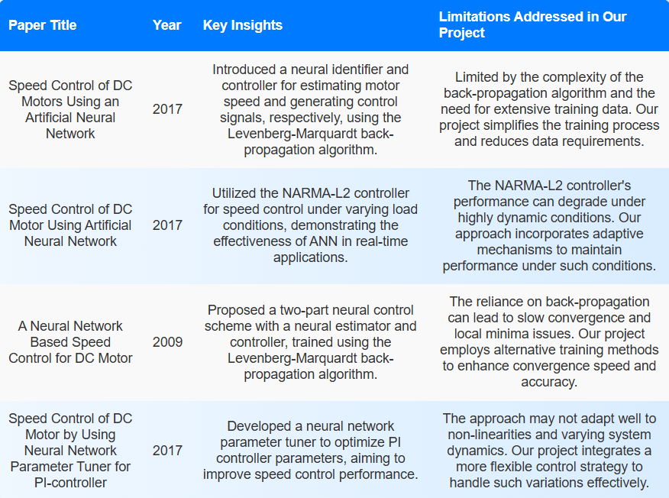
Speed Control of DC Motor Using Artificial Neural Network Introduction DC motors are commonly employed in industry because of their ease and efficiency of speed control. Conventional PID controllers have been employed for this, but they tend to fail in the presence of nonlinearities and varying load conditions. This project investigates the application of an Artificial Neural Network (ANN) to control the speed of a DC motor. The ANN is trained on input data—current, voltage, and load—to estimate the desired speed. Performance of the ANN is then compared against that of a standard PID controller to assess any gains in adaptability and precision..
Literature Review
Speed Control of DC Motor Using Artificial Neural Network
Team Members & Roll Numbers:
BURLA SURAJ - CB.SC.U4AIE24105
VISHNU TEJA - CB.SC.U4AIE24130
SAI KARTHIK - CB.SC.U4AIE24107
MOHAN INANI - CB.SC.U4AIE24136

Slide 3
Speed Control of DC Motor Using Artificial Neural Network Introduction DC motors are commonly employed in industry because of their ease and efficiency of speed control. Conventional PID controllers have been employed for this, but they tend to fail in the presence of nonlinearities and varying load conditions. This project investigates the application of an Artificial Neural Network (ANN) to control the speed of a DC motor. The ANN is trained on input data—current, voltage, and load—to estimate the desired speed. Performance of the ANN is then compared against that of a standard PID controller to assess any gains in adaptability and precision..
Literature Review
Objective
To design and implement an ANN-based controller for DC motor speed regulation.​
To train the ANN using a dataset comprising current, voltage, and load as inputs, with the corresponding motor speed as the output.
To integrate the trained ANN into a MATLAB/Simulink environment, enabling real-time speed prediction and control.
To compare the performance of the ANN-based controller with a traditional PID controller under various operating conditions, assessing metrics such as response time, stability, and accuracy.
Speed Control of DC Motor Using Artificial Neural Network
Team Members & Roll Numbers:
BURLA SURAJ - CB.SC.U4AIE24105
VISHNU TEJA - CB.SC.U4AIE24130
SAI KARTHIK - CB.SC.U4AIE24107
MOHAN INANI - CB.SC.U4AIE24136

Slide 4
Speed Control of DC Motor Using Artificial Neural Network Introduction DC motors are commonly employed in industry because of their ease and efficiency of speed control. Conventional PID controllers have been employed for this, but they tend to fail in the presence of nonlinearities and varying load conditions. This project investigates the application of an Artificial Neural Network (ANN) to control the speed of a DC motor. The ANN is trained on input data—current, voltage, and load—to estimate the desired speed. Performance of the ANN is then compared against that of a standard PID controller to assess any gains in adaptability and precision..
Team Members & Roll Numbers:
BURLA SURAJ - CB.SC.U4AIE24105
VISHNU TEJA - CB.SC.U4AIE24130
SAI KARTHIK - CB.SC.U4AIE24107
MOHAN INANI - CB.SC.U4AIE24136
Speed Control of DC Motor Using Artificial Neural Network
Literature Review
Objective
To design and implement an ANN-based controller for DC motor speed regulation.​
To train the ANN using a dataset comprising current, voltage, and load as inputs, with the corresponding motor speed as the output.
To integrate the trained ANN into a MATLAB/Simulink environment, enabling real-time speed prediction and control.
To compare the performance of the ANN-based controller with a traditional PID controller under various operating conditions, assessing metrics such as response time, stability, and accuracy.
Problem Statement
Traditional PID controllers are limited in terms of managing nonlinear behavior and changing load conditions in DC motors. There is a requirement for a more adaptive and precise control approach to keep the desired motor speed under such situations

Slide 5
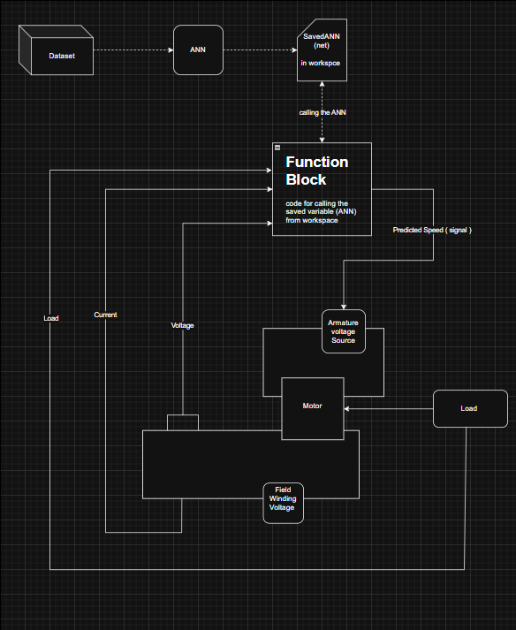
Speed Control of DC Motor Using Artificial Neural Network Introduction DC motors are commonly employed in industry because of their ease and efficiency of speed control. Conventional PID controllers have been employed for this, but they tend to fail in the presence of nonlinearities and varying load conditions. This project investigates the application of an Artificial Neural Network (ANN) to control the speed of a DC motor. The ANN is trained on input data—current, voltage, and load—to estimate the desired speed. Performance of the ANN is then compared against that of a standard PID controller to assess any gains in adaptability and precision..
Team Members & Roll Numbers:
BURLA SURAJ - CB.SC.U4AIE24105
VISHNU TEJA - CB.SC.U4AIE24130
SAI KARTHIK - CB.SC.U4AIE24107
MOHAN INANI - CB.SC.U4AIE24136
Speed Control of DC Motor Using Artificial Neural Network
Literature Review
Block Diagram
Objective
To design and implement an ANN-based controller for DC motor speed regulation.​
To train the ANN using a dataset comprising current, voltage, and load as inputs, with the corresponding motor speed as the output.
To integrate the trained ANN into a MATLAB/Simulink environment, enabling real-time speed prediction and control.
To compare the performance of the ANN-based controller with a traditional PID controller under various operating conditions, assessing metrics such as response time, stability, and accuracy.
Problem Statement
Traditional PID controllers are limited in terms of managing nonlinear behavior and changing load conditions in DC motors. There is a requirement for a more adaptive and precise control approach to keep the desired motor speed under such situations

Slide 6
Speed Control of DC Motor Using Artificial Neural Network Introduction DC motors are commonly employed in industry because of their ease and efficiency of speed control. Conventional PID controllers have been employed for this, but they tend to fail in the presence of nonlinearities and varying load conditions. This project investigates the application of an Artificial Neural Network (ANN) to control the speed of a DC motor. The ANN is trained on input data—current, voltage, and load—to estimate the desired speed. Performance of the ANN is then compared against that of a standard PID controller to assess any gains in adaptability and precision..
Team Members & Roll Numbers:
BURLA SURAJ - CB.SC.U4AIE24105
VISHNU TEJA - CB.SC.U4AIE24130
SAI KARTHIK - CB.SC.U4AIE24107
MOHAN INANI - CB.SC.U4AIE24136
Speed Control of DC Motor Using Artificial Neural Network
Literature Review
Block Diagram
Methodology
The proposed system uses a feedforward Artificial Neural Network (ANN) to control the speed of a Separately Excited DC (SEDC) motor. This motor has independent armature and field windings, and speed regulation is achieved by adjusting the armature voltage. Since the motor speed is closely related to the back EMF, which depends on armature voltage, this method allows precise control.
Step-by-Step Breakdown:
Data Acquisition: A dataset comprising optimal speed, current, voltage, and torque values was obtained from online research and pre-existing sources.
ANN Training: A feedforward neural network was trained on this dataset to understand the relationship between input parameters and motor speed. The trained weights and biases were saved in the MATLAB workspace.
Real-Time Simulation: In Simulink, the system continuously measures current, voltage, and torque from the motor.
Function Block Execution: These real-time values are passed to a function block that loads the trained ANN model from the MATLAB workspace and predicts the motor speed.
Control Action: The predicted speed is converted into a control signal that adjusts the armature voltage to regulate the actual motor speed.
Adaptive Loop: As the torque and load vary, the system dynamically re-evaluates and re-applies the ANN predictions in a continuous loop.
Objective
To design and implement an ANN-based controller for DC motor speed regulation.​
To train the ANN using a dataset comprising current, voltage, and load as inputs, with the corresponding motor speed as the output.
To integrate the trained ANN into a MATLAB/Simulink environment, enabling real-time speed prediction and control.
To compare the performance of the ANN-based controller with a traditional PID controller under various operating conditions, assessing metrics such as response time, stability, and accuracy.
Problem Statement
Traditional PID controllers are limited in terms of managing nonlinear behavior and changing load conditions in DC motors. There is a requirement for a more adaptive and precise control approach to keep the desired motor speed under such situations

Slide 7
Speed Control of DC Motor Using Artificial Neural Network Introduction DC motors are commonly employed in industry because of their ease and efficiency of speed control. Conventional PID controllers have been employed for this, but they tend to fail in the presence of nonlinearities and varying load conditions. This project investigates the application of an Artificial Neural Network (ANN) to control the speed of a DC motor. The ANN is trained on input data—current, voltage, and load—to estimate the desired speed. Performance of the ANN is then compared against that of a standard PID controller to assess any gains in adaptability and precision..
Team Members & Roll Numbers:
BURLA SURAJ - CB.SC.U4AIE24105
VISHNU TEJA - CB.SC.U4AIE24130
SAI KARTHIK - CB.SC.U4AIE24107
MOHAN INANI - CB.SC.U4AIE24136
Speed Control of DC Motor Using Artificial Neural Network
Literature Review
Flow of Methodology:
Block Diagram
Methodology
The proposed system uses a feedforward Artificial Neural Network (ANN) to control the speed of a Separately Excited DC (SEDC) motor. This motor has independent armature and field windings, and speed regulation is achieved by adjusting the armature voltage. Since the motor speed is closely related to the back EMF, which depends on armature voltage, this method allows precise control.
Step-by-Step Breakdown:
Data Acquisition: A dataset comprising optimal speed, current, voltage, and torque values was obtained from online research and pre-existing sources.
ANN Training: A feedforward neural network was trained on this dataset to understand the relationship between input parameters and motor speed. The trained weights and biases were saved in the MATLAB workspace.
Real-Time Simulation: In Simulink, the system continuously measures current, voltage, and torque from the motor.
Function Block Execution: These real-time values are passed to a function block that loads the trained ANN model from the MATLAB workspace and predicts the motor speed.
Control Action: The predicted speed is converted into a control signal that adjusts the armature voltage to regulate the actual motor speed.
Adaptive Loop: As the torque and load vary, the system dynamically re-evaluates and re-applies the ANN predictions in a continuous loop.
Objective
To design and implement an ANN-based controller for DC motor speed regulation.​
To train the ANN using a dataset comprising current, voltage, and load as inputs, with the corresponding motor speed as the output.
To integrate the trained ANN into a MATLAB/Simulink environment, enabling real-time speed prediction and control.
To compare the performance of the ANN-based controller with a traditional PID controller under various operating conditions, assessing metrics such as response time, stability, and accuracy.
Dataset Sourced from Internet
Train Feedforward ANN
Save ANN Weights in MATLAB Workspace
Problem Statement
Traditional PID controllers are limited in terms of managing nonlinear behavior and changing load conditions in DC motors. There is a requirement for a more adaptive and precise control approach to keep the desired motor speed under such situations
Predict Speed Using ANN
Function Block Loads ANN Model
Simulink Measures Current, Voltage, Torque
Generate Control Signal
Adjust Armature Voltage
Motor Speed Regulated
Loop Continues with New Inputs

Slide 8
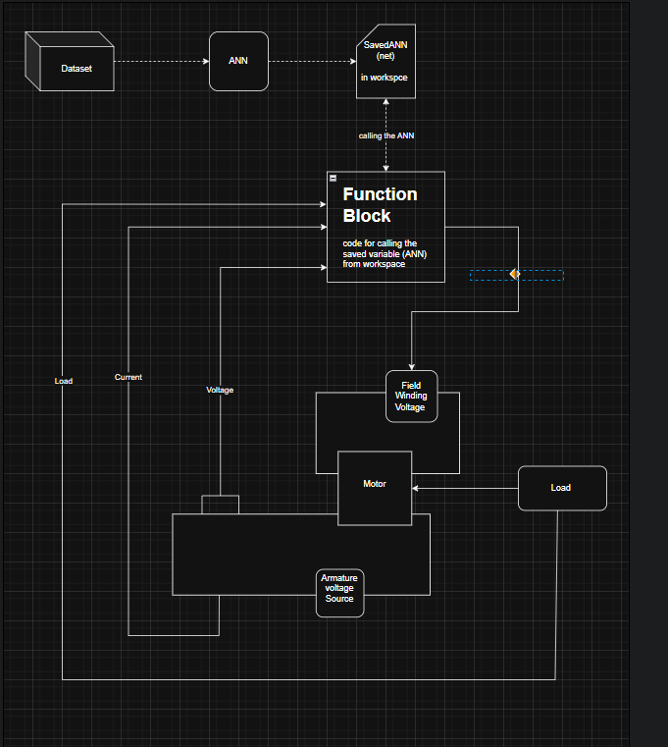
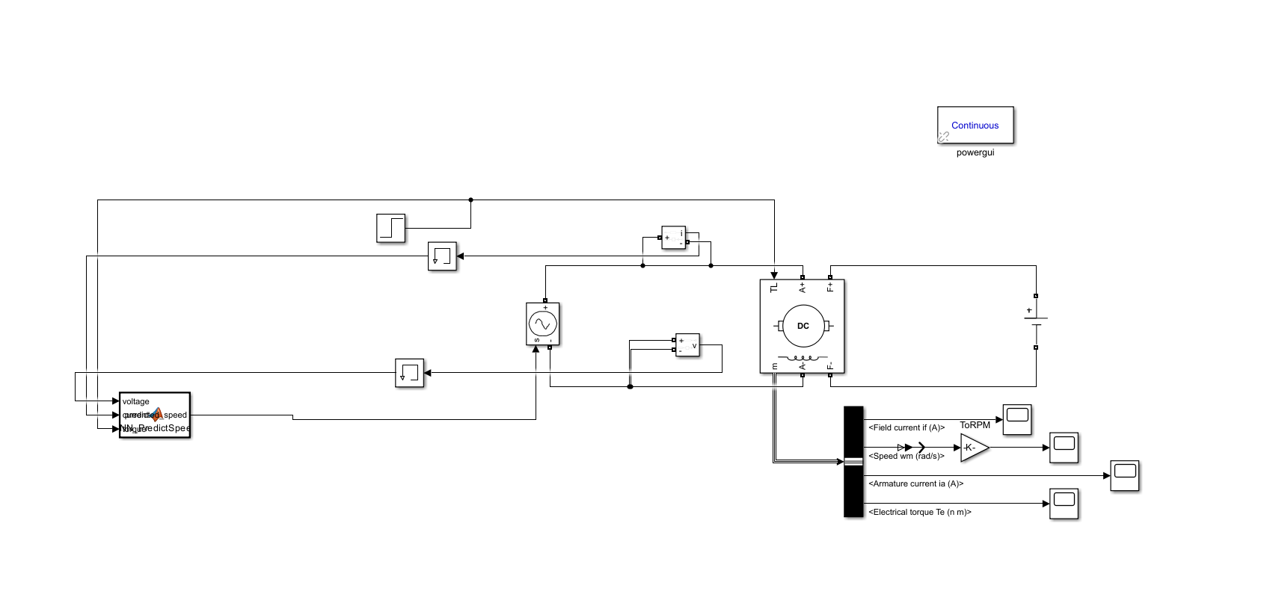
Speed Control of DC Motor Using Artificial Neural Network Introduction DC motors are commonly employed in industry because of their ease and efficiency of speed control. Conventional PID controllers have been employed for this, but they tend to fail in the presence of nonlinearities and varying load conditions. This project investigates the application of an Artificial Neural Network (ANN) to control the speed of a DC motor. The ANN is trained on input data—current, voltage, and load—to estimate the desired speed. Performance of the ANN is then compared against that of a standard PID controller to assess any gains in adaptability and precision..
Team Members & Roll Numbers:
BURLA SURAJ - CB.SC.U4AIE24105
VISHNU TEJA - CB.SC.U4AIE24130
SAI KARTHIK - CB.SC.U4AIE24107
MOHAN INANI - CB.SC.U4AIE24136
Speed Control of DC Motor Using Artificial Neural Network
Literature Review
Block Diagram
Simulink Model
Flow of Methodology:
Methodology
The proposed system uses a feedforward Artificial Neural Network (ANN) to control the speed of a Separately Excited DC (SEDC) motor. This motor has independent armature and field windings, and speed regulation is achieved by adjusting the armature voltage. Since the motor speed is closely related to the back EMF, which depends on armature voltage, this method allows precise control.
Step-by-Step Breakdown:
Data Acquisition: A dataset comprising optimal speed, current, voltage, and torque values was obtained from online research and pre-existing sources.
ANN Training: A feedforward neural network was trained on this dataset to understand the relationship between input parameters and motor speed. The trained weights and biases were saved in the MATLAB workspace.
Real-Time Simulation: In Simulink, the system continuously measures current, voltage, and torque from the motor.
Function Block Execution: These real-time values are passed to a function block that loads the trained ANN model from the MATLAB workspace and predicts the motor speed.
Control Action: The predicted speed is converted into a control signal that adjusts the armature voltage to regulate the actual motor speed.
Adaptive Loop: As the torque and load vary, the system dynamically re-evaluates and re-applies the ANN predictions in a continuous loop.
Objective
To design and implement an ANN-based controller for DC motor speed regulation.​
To train the ANN using a dataset comprising current, voltage, and load as inputs, with the corresponding motor speed as the output.
To integrate the trained ANN into a MATLAB/Simulink environment, enabling real-time speed prediction and control.
To compare the performance of the ANN-based controller with a traditional PID controller under various operating conditions, assessing metrics such as response time, stability, and accuracy.
Dataset Sourced from Internet
Train Feedforward ANN
Save ANN Weights in MATLAB Workspace
Problem Statement
Traditional PID controllers are limited in terms of managing nonlinear behavior and changing load conditions in DC motors. There is a requirement for a more adaptive and precise control approach to keep the desired motor speed under such situations
Predict Speed Using ANN
Function Block Loads ANN Model
Simulink Measures Current, Voltage, Torque
Generate Control Signal
Adjust Armature Voltage
Motor Speed Regulated
Loop Continues with New Inputs

Slide 9
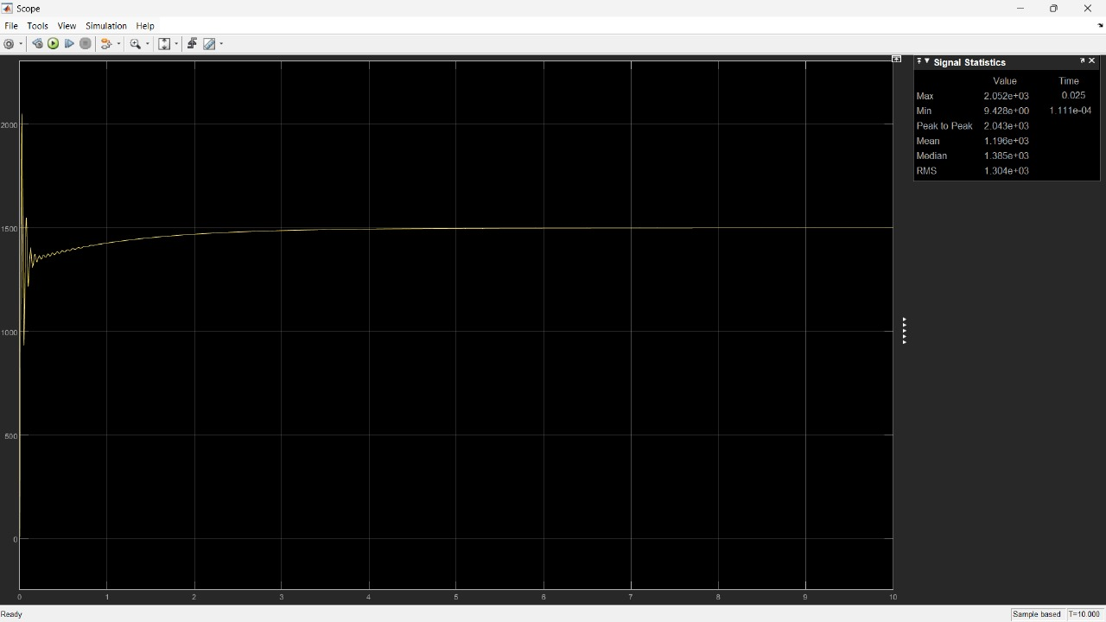
Flow of Methodology:
Block Diagram
Results
Without ANN (PID Controller)
Without the ANN model (using the PID controller), the system shows less accuracy, greater oscillations, and the system struggles to reach the desired speed accurately. The difference between the desired and actual speed is more noticeable.
Simulink Model
Dataset Sourced from Internet
Train Feedforward ANN
Save ANN Weights in MATLAB Workspace
Predict Speed Using ANN
Function Block Loads ANN Model
Simulink Measures Current, Voltage, Torque
Generate Control Signal
Adjust Armature Voltage
Motor Speed Regulated
Loop Continues with New Inputs

Slide 10
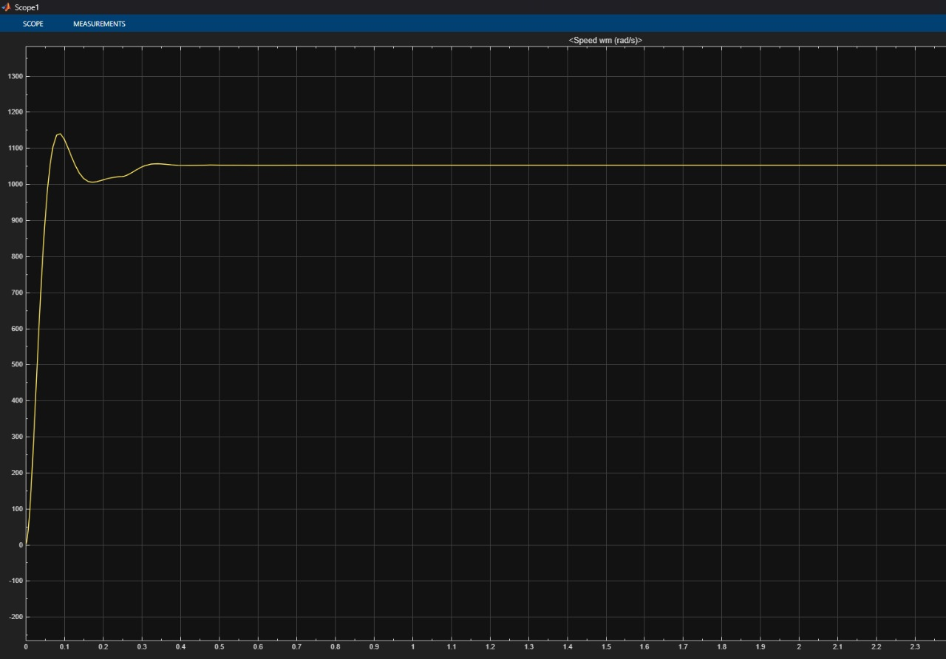
Flow of Methodology:
Block Diagram
Results
With ANN (ANN Controller)
With the ANN model, the speed is predicted through a function block, leading to higher accuracy and less oscillation. The system reaches the desired speed with improved performance.
Without ANN (PID Controller)
Without the ANN model (using the PID controller), the system shows less accuracy, greater oscillations, and the system struggles to reach the desired speed accurately. The difference between the desired and actual speed is more noticeable.
Simulink Model
Dataset Sourced from Internet
Train Feedforward ANN
Save ANN Weights in MATLAB Workspace
Predict Speed Using ANN
Function Block Loads ANN Model
Simulink Measures Current, Voltage, Torque
Generate Control Signal
Adjust Armature Voltage
Motor Speed Regulated
Loop Continues with New Inputs

Slide 11
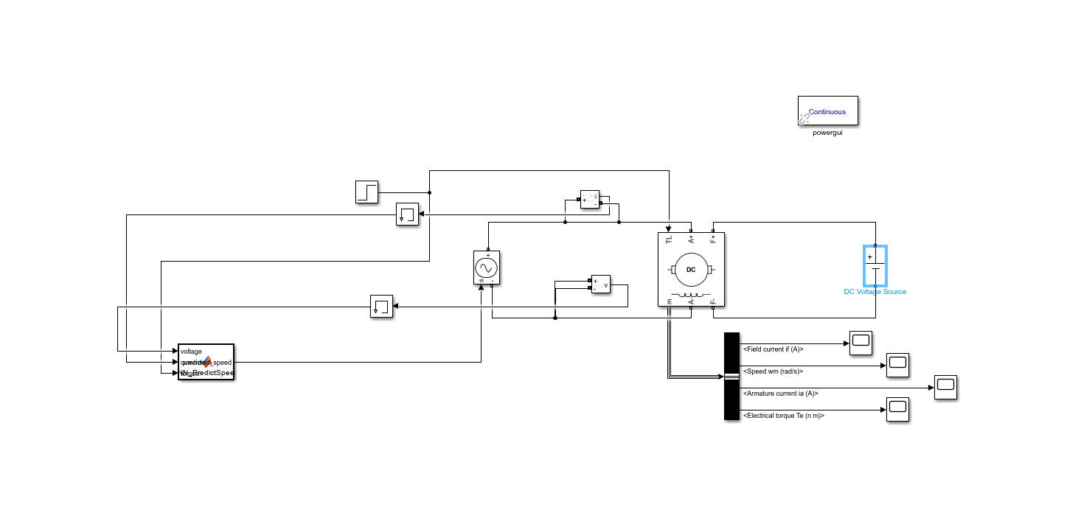
Flow of Methodology:
Block Diagram
Results
Without ANN (PID Controller)
Without the ANN model (using the PID controller), the system shows less accuracy, greater oscillations, and the system struggles to reach the desired speed accurately. The difference between the desired and actual speed is more noticeable.
With ANN (ANN Controller)
With the ANN model, the speed is predicted through a function block, leading to higher accuracy and less oscillation. The system reaches the desired speed with improved performance.
Simulink Model
Conclusion
ANN-based speed control provides superior performance and robustness for SEDC drives, making it a promising solution for industrial variable-speed applications.
--Thank You--
Dataset Sourced from Internet
Train Feedforward ANN
Save ANN Weights in MATLAB Workspace
Predict Speed Using ANN
Function Block Loads ANN Model
Simulink Measures Current, Voltage, Torque
Generate Control Signal
Adjust Armature Voltage
Motor Speed Regulated
Loop Continues with New Inputs

Slide 12
Flow of Methodology:
Results
Block Diagram
Without ANN (PID Controller)
Without the ANN model (using the PID controller), the system shows less accuracy, greater oscillations, and the system struggles to reach the desired speed accurately. The difference between the desired and actual speed is more noticeable.
With ANN (ANN Controller)
With the ANN model, the speed is predicted through a function block, leading to higher accuracy and less oscillation. The system reaches the desired speed with improved performance.
Simulink Model
Conclusion
ANN-based speed control provides superior performance and robustness for SEDC drives, making it a promising solution for industrial variable-speed applications.
--Thank You--

Slide 13
Flow of Methodology:
Results
Block Diagram
Without ANN (PID Controller)
Without the ANN model (using the PID controller), the system shows less accuracy, greater oscillations, and the system struggles to reach the desired speed accurately. The difference between the desired and actual speed is more noticeable.
With ANN (ANN Controller)
With the ANN model, the speed is predicted through a function block, leading to higher accuracy and less oscillation. The system reaches the desired speed with improved performance.
Simulink Model
Conclusion
ANN-based speed control provides superior performance and robustness for SEDC drives, making it a promising solution for industrial variable-speed applications.
--Thank You--

